Slide 1
Name : Anjali kumari
Roll no. : 8
Dept. : IT
Year : 4th yr (8th sem)
Subject : cryptography assignment

Slide 2
Sniffing
Topic Name :-

Slide 3
What is sniffing?
Sniffing is a process of monitoring and capturing all data packets passing through given network. Sniffers are used by network/system administrator to monitor and troubleshoot network traffic. Attackers use sniffers to capture data packets containing sensitive information such as password, account information etc. Sniffers can be hardware or software installed in the system. By placing a packet sniffer on a network in promiscuous mode, a malicious intruder can capture and analyze all of the network traffic.

Slide 4
Types of sniffing
There are two types:
Active Sniffing: Sniffing in the switch is active sniffing. A switch is a point to point network device. The switch regulates the flow of data between its ports by actively monitoring the MAC address on each port, which helps it pass data only to its intended target. In order to capture the traffic between target sniffers has to actively inject traffic into the LAN to enable sniffing of the traffic. This can be done in various ways. Passive Sniffing: This is the process of sniffing through the hub. Any traffic that is passing through the non-switched or unbridged network segment can be seen by all machines on that segment. Sniffers operate at the data link layer of the network. Any data sent across the LAN is actually sent to each and every machine connected to the LAN. This is called passive since sniffers placed by the attackers passively wait for the data to be sent and capture them.

Slide 5
What can be sniffed?
One can sniff the following sensitive information from a network − 1) Email traffic 2) FTP passwords 3.) Web traffics 4.) Telnet passwords 5.) Router configuration 6.) Chat sessions 7.) DNS traffic

Slide 6
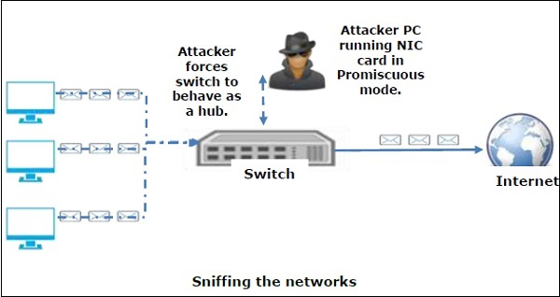
How sniffing works ?

Slide 7
Prevention
To prevent networks from sniffing attacks, organizations and individual users should keep away from applications that are using insecure protocols, like basic HTTP authentication, File Transfer Protocol (FTP), and Telnet. Instead, secure protocols such as HTTPS, Secure File Transfer Protocol (SFTP), and Secure Shell (SSH) should be preferred. In case there is a necessity for using any insecure protocol in any application, all the data transmission should be encrypted. If required, VPN (Virtual Private Networks) can be used to provide secure access to users.

Slide 8
Topic Name:-
Spoofing

Slide 9
What is Spoofing ?
Spoofing is an act of disguising a communication from an unknown source as being from a known, trusted source. Spoofing can apply to emails, phone calls, and websites, or can be more technical, such as a computer spoofing an IP address, Address Resolution Protocol (ARP), or Domain Name System (DNS) server. Spoofing can be used to gain access to a target’s personal information, spread malware through infected links or attachments, bypass network access controls, or redistribute traffic to conduct a denial-of-service attack. Spoofing is often the way a bad actor gains access in order to execute a larger cyber attack such as an advanced persistent threat or a man-in-the-middle attack.

Slide 10
Types of spoofing :-
1. Email Spoofing
2. IP Spoofing
3. ARP Spoofing
4. DNS Server Spoofing

Slide 11
Email Spoofing Attacks :- Email spoofing attacks are where an attacker sends an email imitating another sender. In these attacks, the sender field is spoofed to show fake contact details. The attacker impersonates this entity and then sends you an email requesting information. These attacks are often used to pose as administrators and ask other members of staff for account details.

Slide 12
IP Spoofing Attack An IP spoofing attack is where an attacker tries to impersonate an IP address so that they can pretend to be another user. During an IP address spoofing attack the attacker sends packets from a false source address. These packets are sent to devices within the network and operate much like a DoS attack. The attacker uses multiple packet addresses to overwhelm a device with too many packets.

Slide 13
An ARP spoofing attack is an attack that uses the Address Resolution Protocol to fish for information. In an ARP spoofing attack the attacker sends ARP messages out across a network in an attempt to connect their MAC address with the IP address of a member of staff. The attacker waits quietly on the network until they manage to crack the IP address. Once the IP address has been cracked, the attacker can intercept data in between the computer and the router. Then data sent to the member of staff is actually sent on to the attacker’s IP address. The end result is data in the hands of the attacker. The attacker can then use IP addresses throughout your network against you to launch a denial-of-service DOS attack. One of the most important things to note about ARP spoofing attacks is that they can only work on LANs that use the ARP protocol.
ARP Spoofing Attack:-

Slide 14
DNS Spoofing Attack:- DNS or domain name system attacks are where attackers jumble up the list of public IP addresses. DNS servers have a database of public IP addresses and hostnames that are used to help with navigating the network. When a DNS attack occurs, the attacker changes domain names so that they are rerouted to a new IP address. One example of this is if you enter a website URL and you are then sent to a spoofed domain instead of the website that you originally wanted to go to. This is a popular way for attackers to spread worms and viruses into networks.

Slide 15
Spoofing can be applied to a number of communication methods and employ various levels of technical know-how. Spoofing can be used carry out phishing attacks, which are scams to gain sensitive information from individuals or organizations. The following different examples of spoofing attack methods gives more detail on how different attacks work.
How spoofing works :-

Slide 16
How to prevent :-
Packet Filtering
Stop using trust relationships
Deploy a spoof detection tool
Use encrypted protocols
Deploy antivirus software on your devices
Install firewalls on your network
Start using VPNs

